Slide 1
Deployable Tools for Engineering Efficiency
Austin Funk

Slide 2

Introduction
Systems Engineering Intern managed by Andrew Ward
Diagnostics R&D
Software focused projects for Genius Digital Diagnostics instrument
Brown University 2025 studying Computer Engineering
Teaching assistant, music, engineering/computer science clubs
Saxophone, reading, and being outdoors

Slide 3
Projects Overview
Overall goal: Build beneficial deployable tools that will save time in the day-to-day for full time engineers
SQL project
Problem: Changing entries in the SQL database is time consuming, unintuitive, and can cause major issues.
Goal: Build a tool that allows easy database access for frequent changes during development and adds another layer of security.
Camera project
Problem: Mechanical issues with the Genius that occur overnight in the PEG lab cannot be easily diagnosed.
Goal: Put together an automatic visual recording system with footage that is easy to navigate, greatly reducing the amount of time engineers spend parsing logs.
Throughput feature
Problem: It is currently difficult to quantify throughput time after improvements to the Genius system and software.
Goal: Add database flags that make logging throughput information easy, making it easier to concretely quantify improvement.

Slide 4
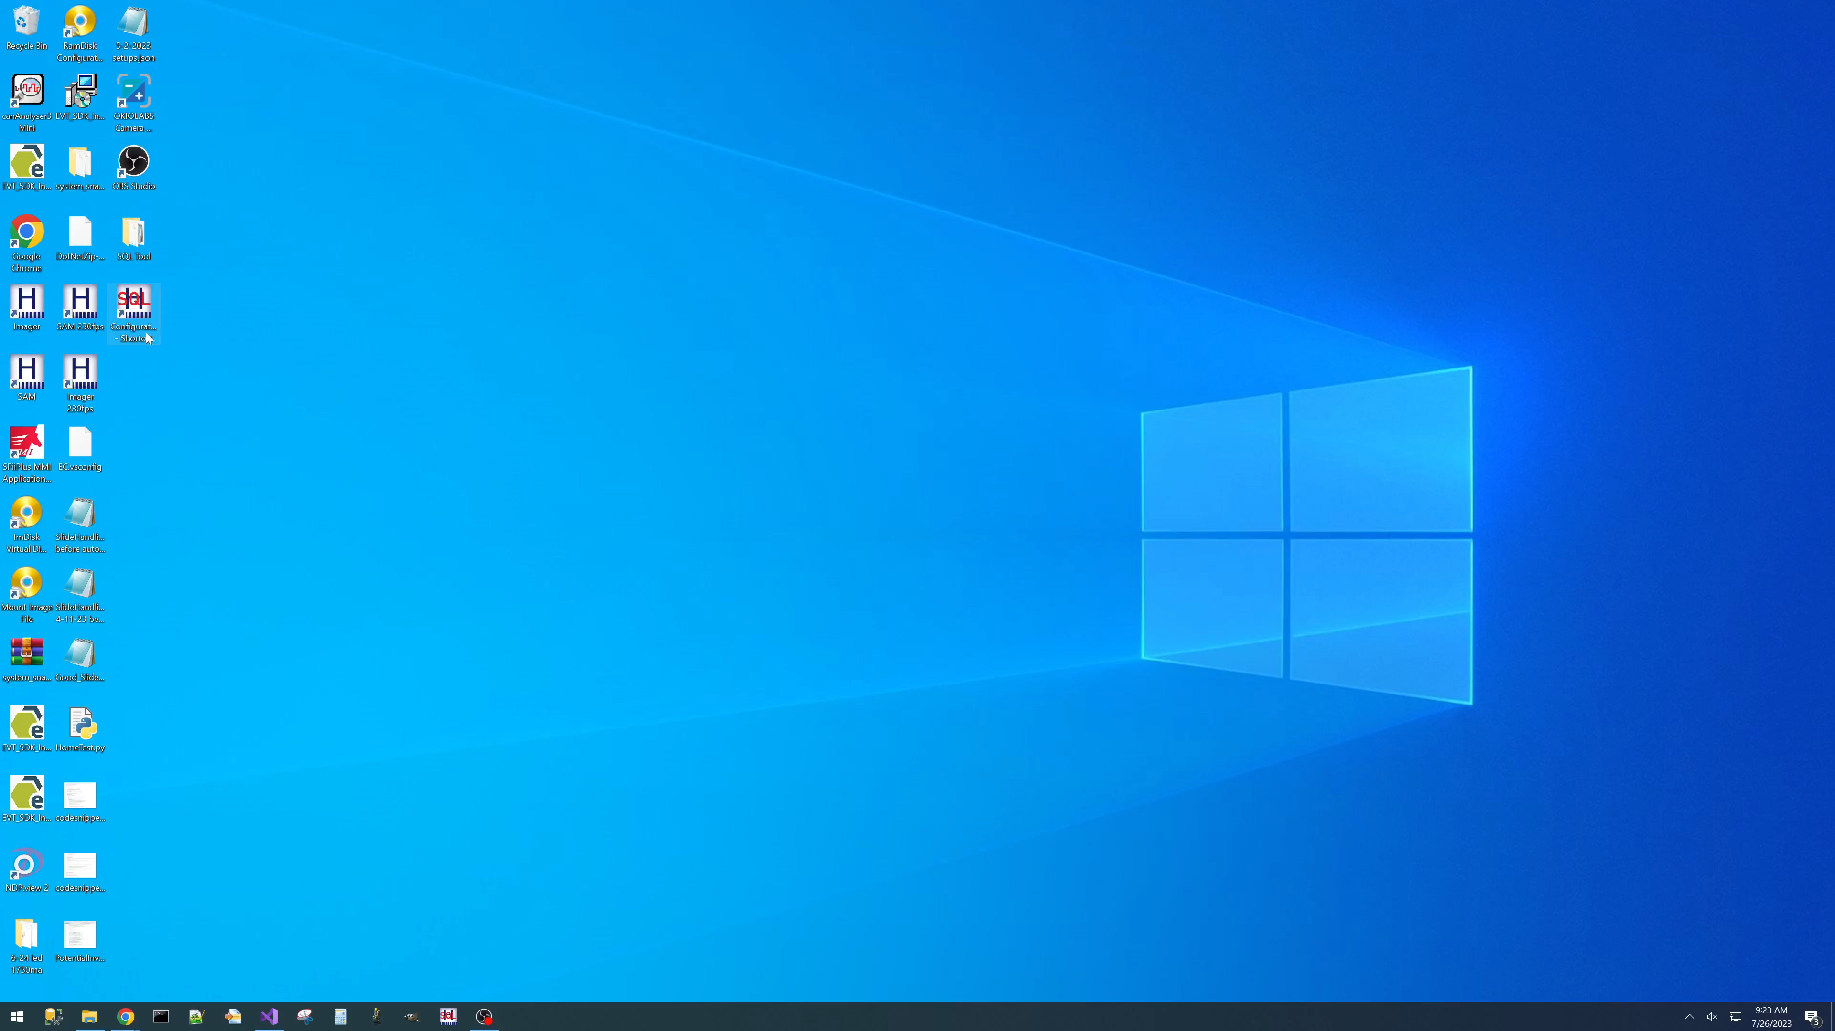
SQL Project
Project Features
Easily change settings, allows for continuous testing and improvement
Favorite settings with default value indicators (new to this tool)
Import/export current values in multiple formats, allows for multiple set ups
Process
Learned C# and WPF
Build minimum viable product
Integrate feedback and requested features
Thank you to Jim, Jeff, and Steve for the constant help and ideas!

Slide 5
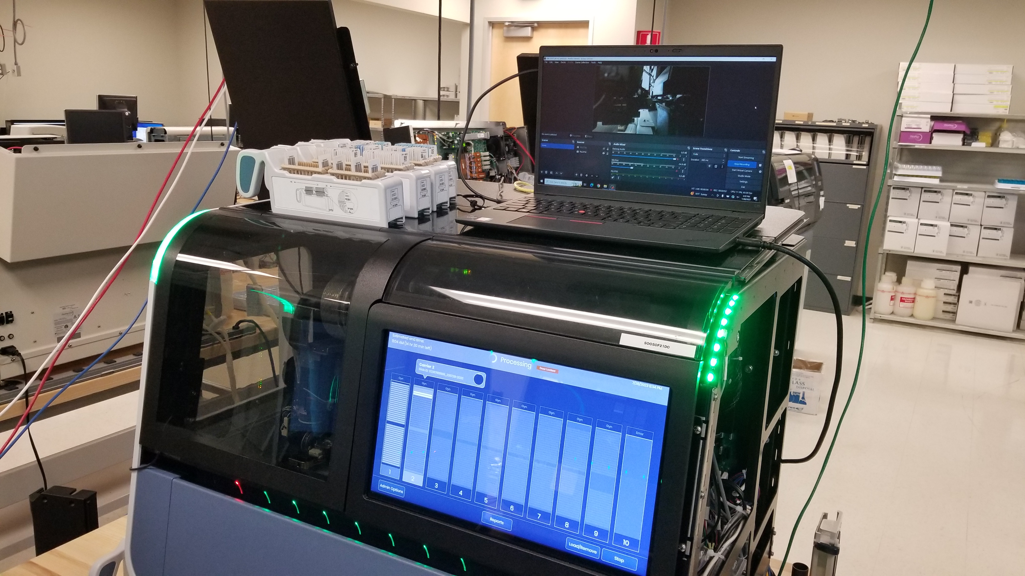
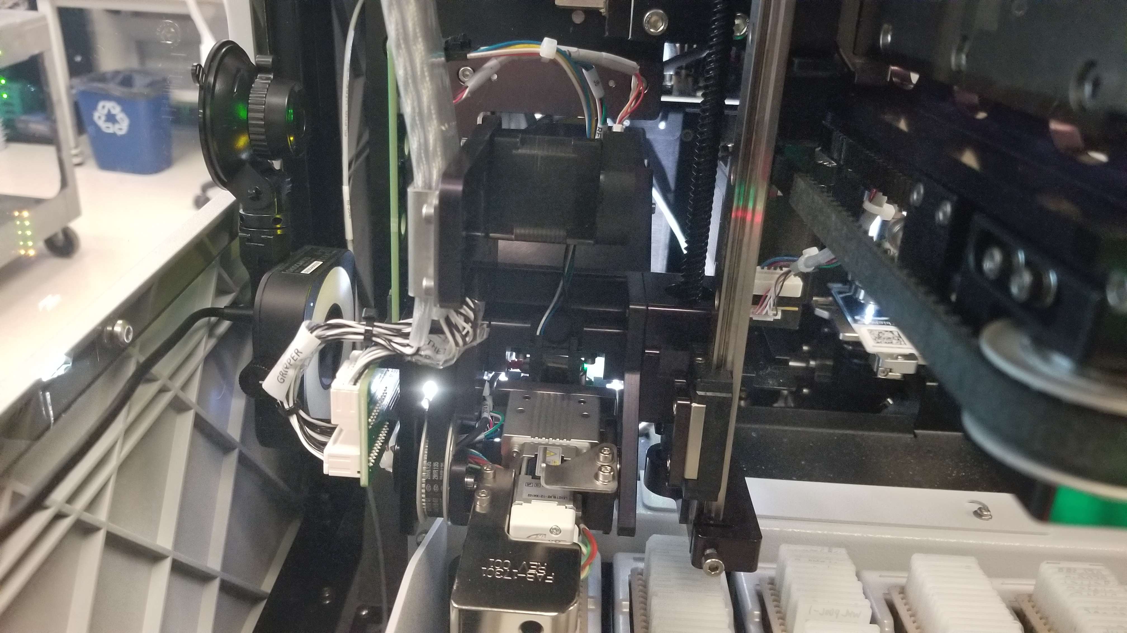

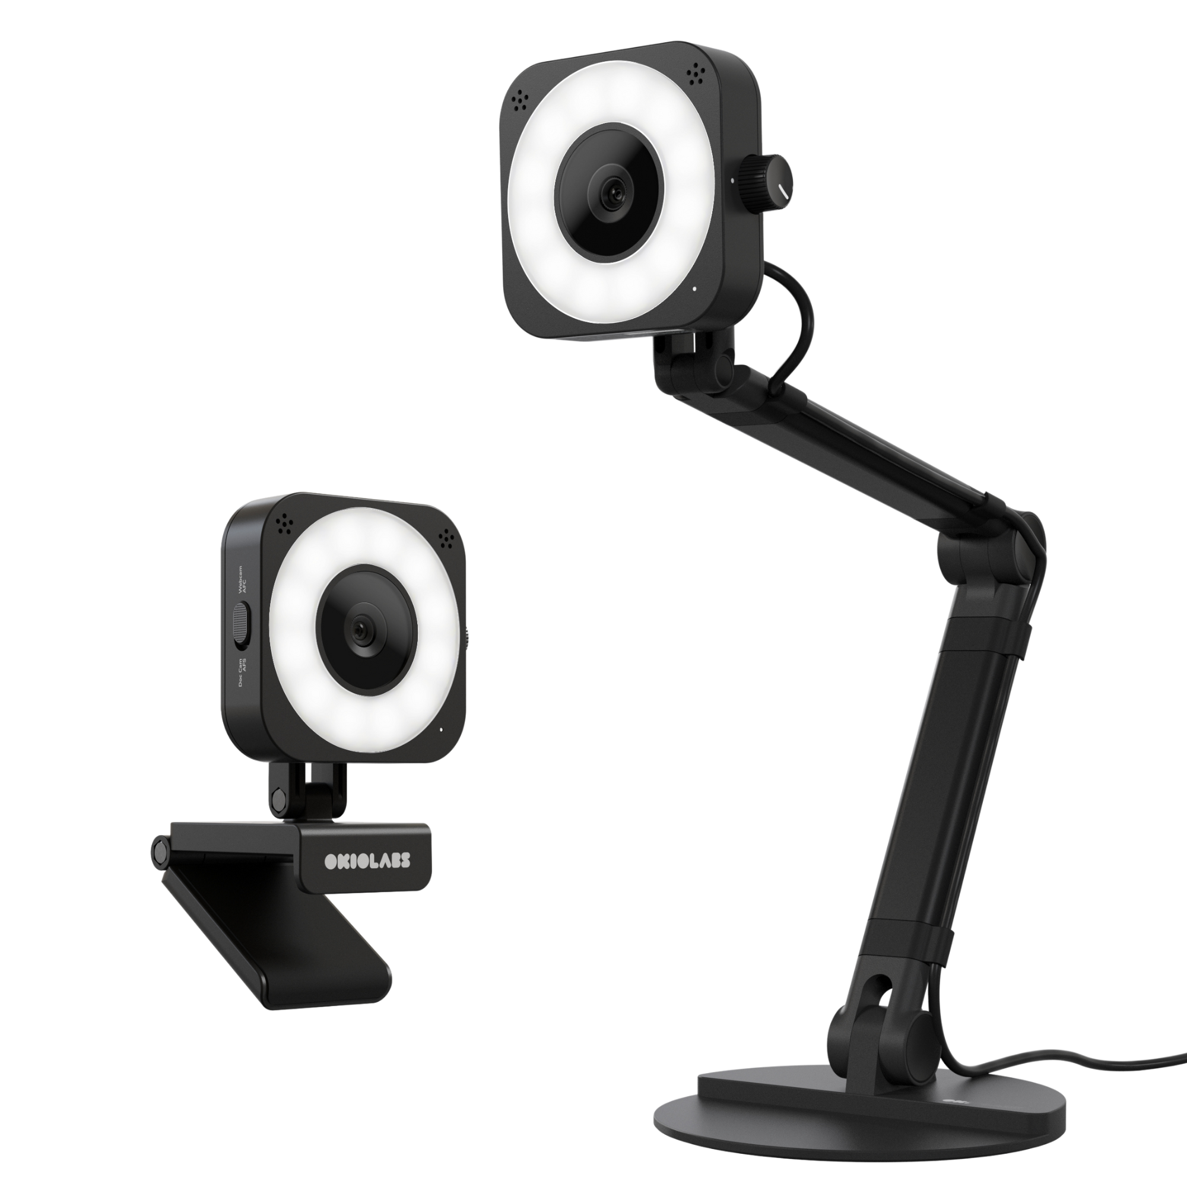
Camera Project
Project Timeline
Found camera and video software that fit specifications (OKIOCAM X1, OBS)
Wrote Python script to continuously record footage and delete old footage
Use other plugins to make the script and OBS work seamlessly
Final product
Reduces debugging time for 1.1.1 validation, speeds up verification
Cameras mounted in four Genius imagers with plans for more
Video has been almost constantly recording since 7/12 with no issues
Footage is organized on a laptop based on Genius ID and time of recording
Videos are time stamped to match with error time stamps from the Genius, easy to locate issues
Detailed user guides for set up, maintenance, and potential issues with solutions

Slide 6
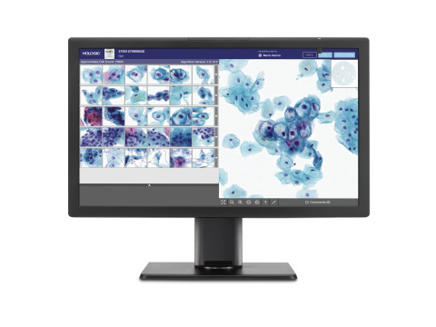

Throughput Feature (Still in Development)
Project Progress
Able to log throughput data, all necessary flags exist and are accessible in the codebase and SQL tool
Goals
Provide accurate, reasonable data, including average scan time, transition time, and more
Feature needs to be easy to use and understand
Use this feature to increase throughput and ultimately increase customer satisfaction
Stretch Goals
Use a separate log from the main imager log
Provide a UI, either within SAM or as a separate developer facing application, that graphs the data

Slide 7
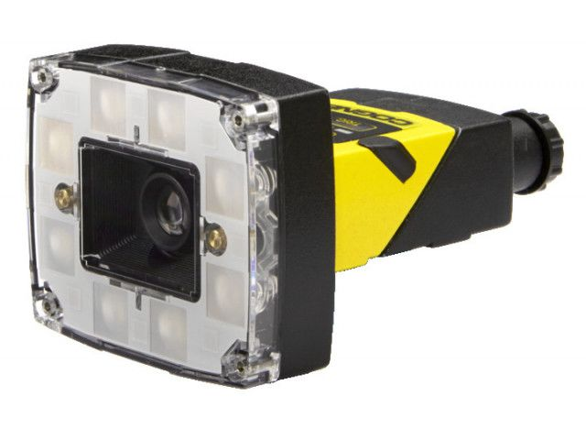

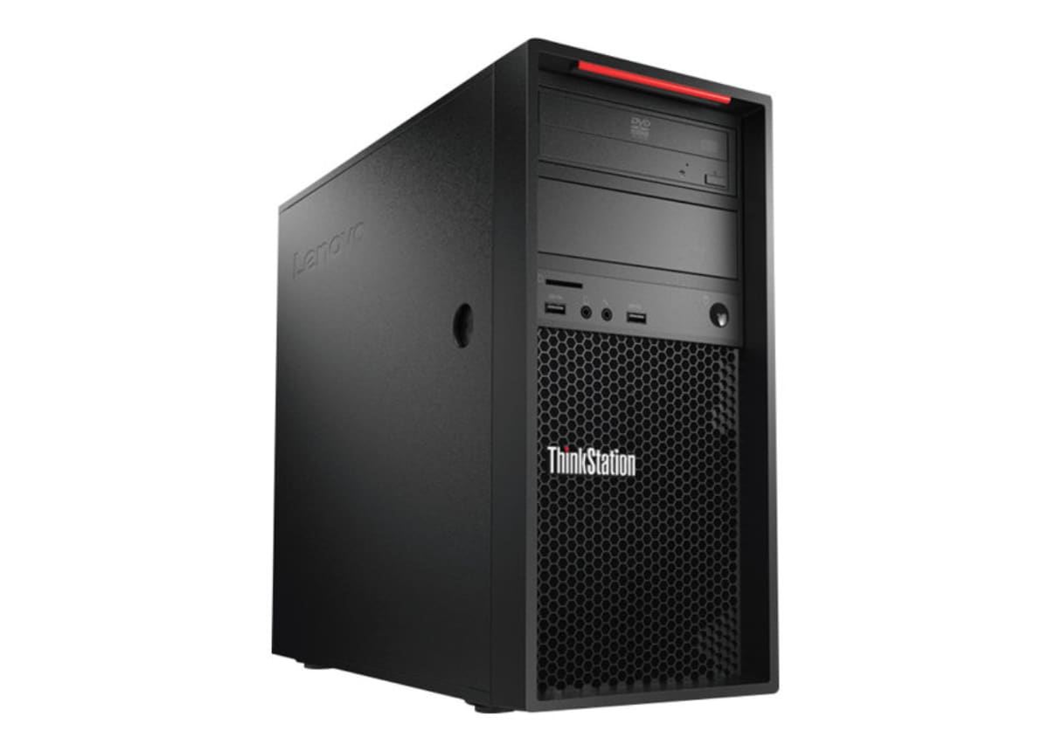
Future Projects
Next Projects
Development project using computer vision to perform repeatability testing on the gantry
Quantify CPU hardware changes using my throughput feature

Slide 8
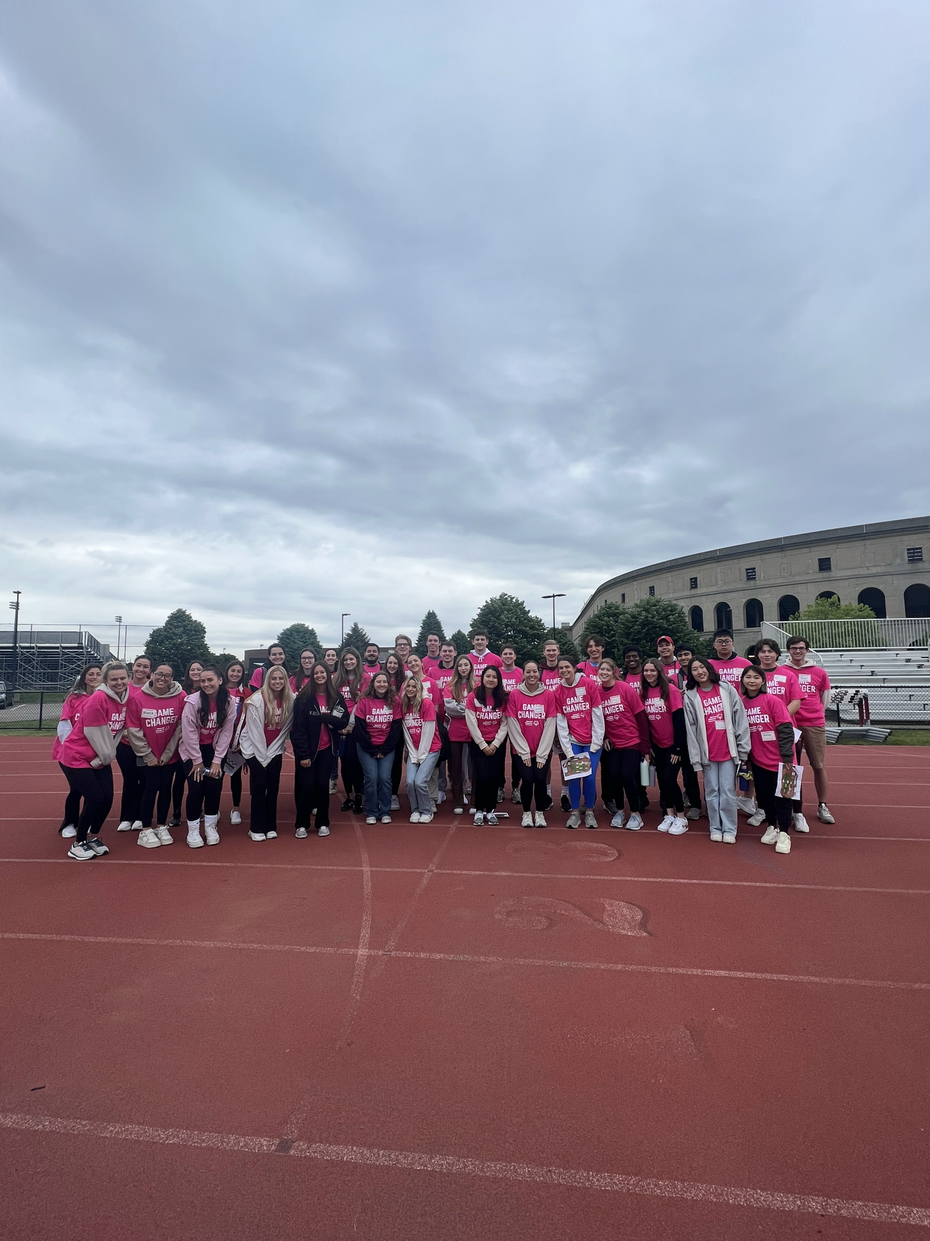
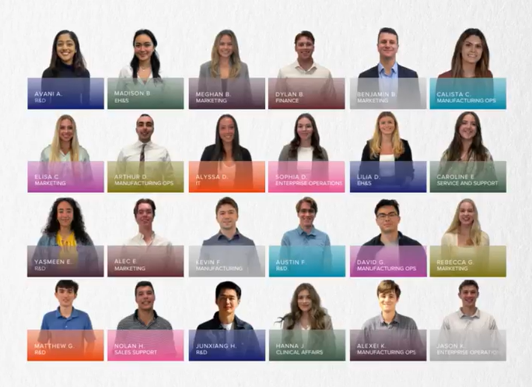
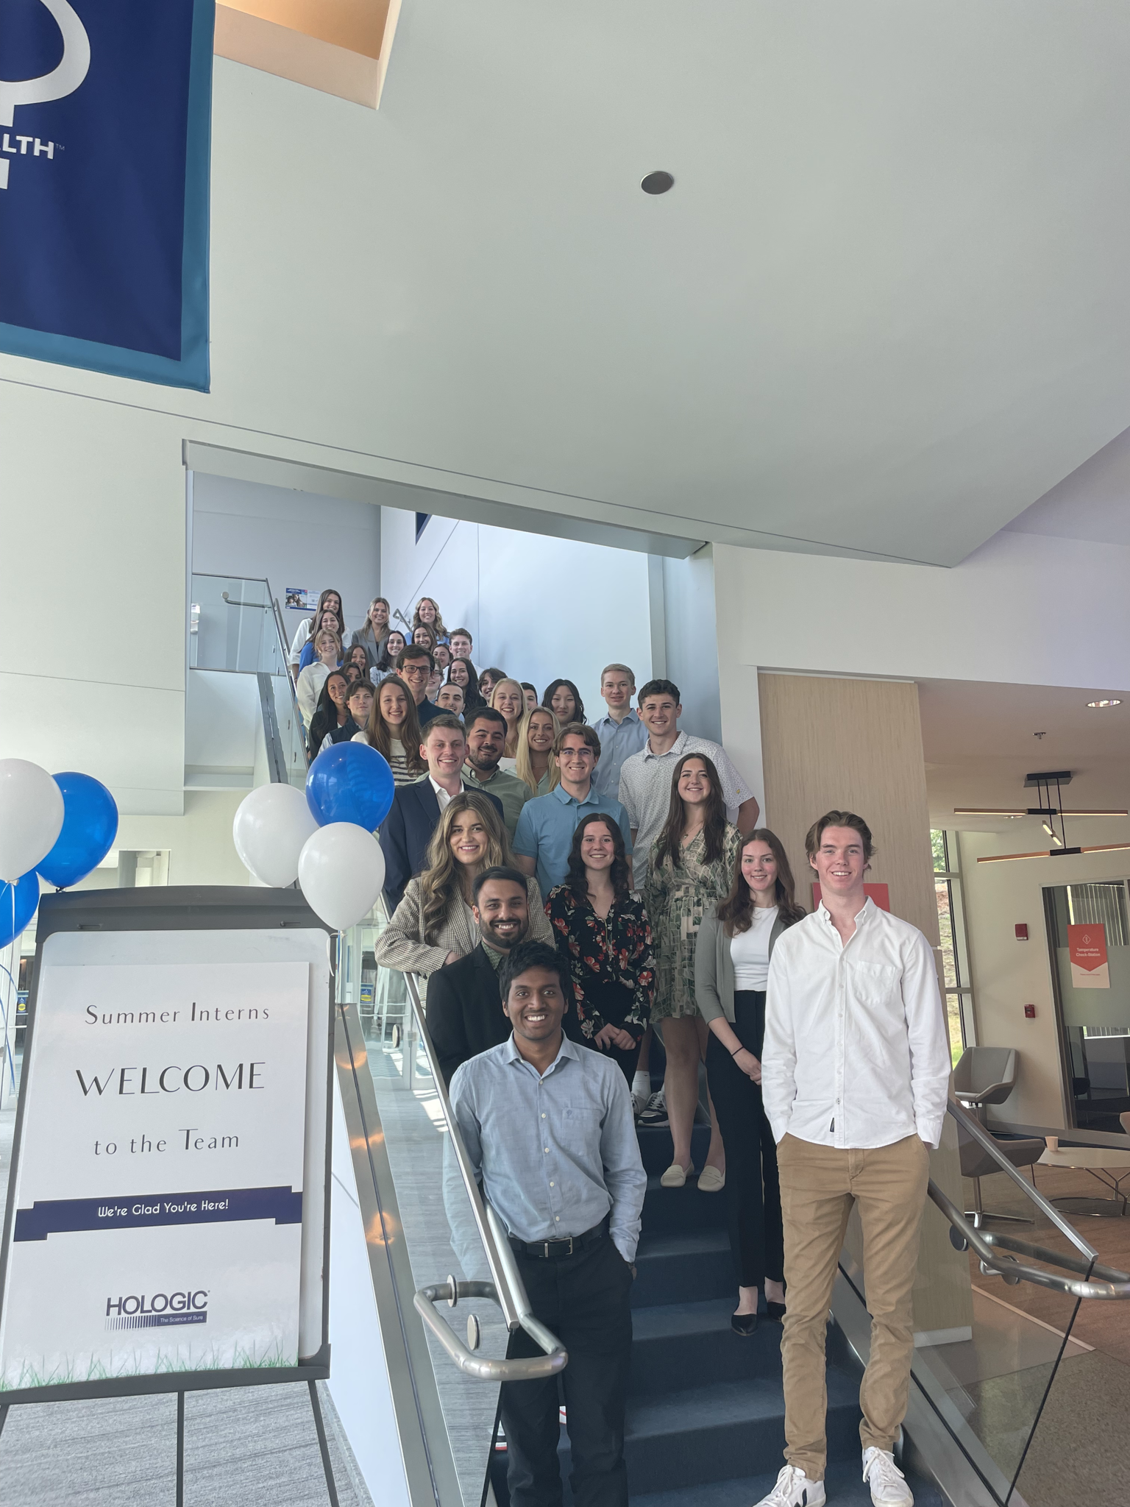
My Experience
Overall Experience
Learned a lot, including soft skills
Great connection with other interns and my manager
Projects felt like they mattered
Still nearly four weeks left of the internship
Very positive experience

Slide 9
Thank You!
Andrew Ward
Jim Fox
Jeff Struven
Steve Failla
Grant Van Dyke
And everyone else at Hologic! Thank you for a great summer!

